Slide 1

UG NKABOM HONOURS PROGRAMME
ONION GUARD
A Strategic Proposal for Six-Month Product Development, Field
Validation, Public Launch, Visibility and Commercialisation
STRATEGIC PROPOSAL | 2026

Slide 2
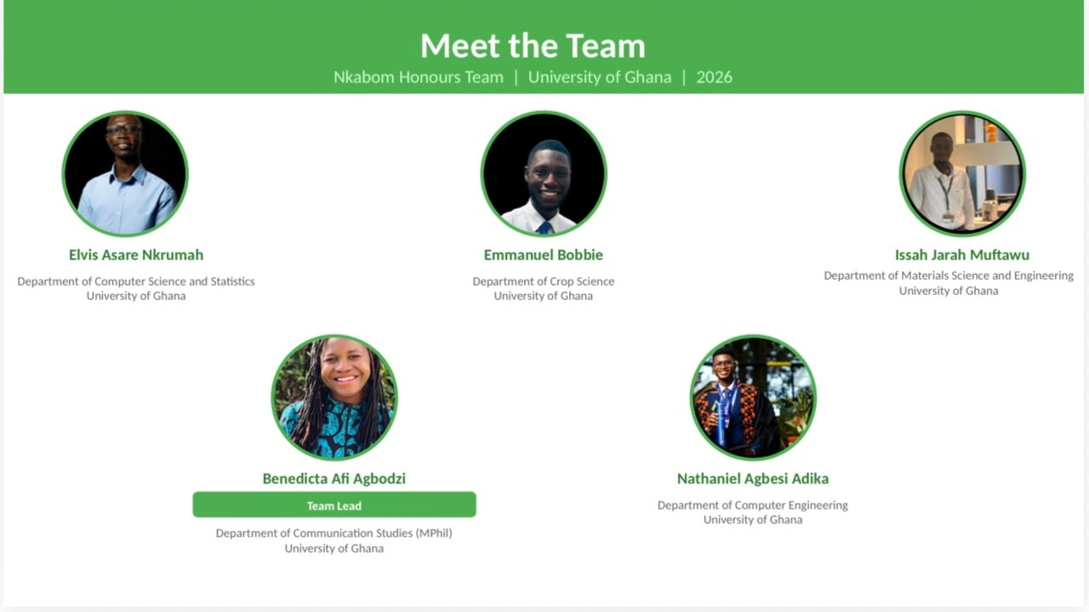

Slide 3
CONTENTS
01
Background & Context
The programme, the journey, the problem
The Strategic
Journey
02
The Opportunity & Product
Meet Onion Guard and its ecosystem
03
Audience & Stakeholders
Users, institutions and their roles
04
Objectives & Strategy
Targets, the big idea, the framework
05
Content & Storytelling
Pillars, weekly system, amplification
06
Six-Month Execution Roadmap
Month-by-month plan, launch, field testing
07
Conversion & Commercialisation
Funnel, partnerships, revenue model
From problem to prototype to a validated, visible and
commercially positioned agricultural technology platform.
08
Resources, Budget & Measurement
LogFrame, budget, KPIs, risk, outcomes
OG
ONION GUARD | UG NKABOM HONOURS PROGRAMME
1

Slide 4
01
BACKGROUND & CONTEXT
Onion Guard emerged from field research, honest conversation with traders, and a scholar team willing to build.
OG
ONION GUARD | UG NKABOM HONOURS PROGRAMME

Slide 5
BACKGROUND
The UG Nkabom Honours Programme
THE JOURNEY SO FAR
The UG Nkabom Honours Programme is a collaborative initiative of the University of Ghana, McGill University and the Mastercard Foundation, developed to give scholars hands-on experience turning research into applied innovation.
Onion Guard is a project developed by scholars of the inaugural cohort of the programme, in response to challenges identified within Ghana's agri-food system.
The programme pairs academic training with real fieldwork, requiring scholars to identify a genuine problem, research it directly with the people affected, and design a working response.
Onion Guard is therefore not a homegrown, research-informed agricultural technology built by young Ghanaian innovators for a problem they investigated first-hand.
1
A Real
Problem
2
Field
Research
3
Insight &
Ideation
4
System
Design
5
Working
Prototype
OG
ONION GUARD | UG NKABOM HONOURS PROGRAMME
3

Slide 6
THE PROBLEM
Two Connected Challenges
Many crop production challenges are identified only after they have already caused significant damage or financial loss.
Farmers and other agri-food stakeholders have limited accessible tools for early disease identification, timely agricultural information, market connections and food safety assessment.
Even when a promising technology solution exists, it is rarely used by the people and institutions that need it most.
CHALLENGE 1
How do we make the product better?
CHALLENGE 2
How do we get the right people to know about it, use it, adopt it, and potentially pay for it?
THE CENTRAL PROGRAMME CHALLENGE
How do we move Onion Guard from a working prototype to a tested, improved, visible, adopted and commercially positioned solution?
OG
ONION GUARD | UG NKABOM HONOURS PROGRAMME
4

Slide 7
THE PROBLEM IN NUMBERS
The Research Behind the Innovation
Primary field research was conducted across three major onion trading hubs in Greater Accra, engaging 38 onion traders directly.
Makola
Market
Agbogbloshie
Market
Adjen Kotoku
Market
38 onion traders engaged across all three markets
19.9%
84.2%
73.7%
Average onion loss rate per batch across the sample
Of surveyed traders owned a smartphone
Expressed interest in a buyer-facing e-commerce application
TWO INSIGHTS: the onion value chain contains some inefficiencies and risks, and most potential users already own smartphones and want digital tools.
OG
ONION GUARD | UG NKABOM HONOURS PROGRAMME

Slide 8
02
THE OPPORTUNITY & PRODUCT
Onion Guard sits at the intersection of agrifood, AI, mobile technology and young Ghanaian innovation. The next six months decide what it becomes.
OG
ONION GUARD | UG NKABOM HONOURS PROGRAMME

Slide 9

THE OPPORTUNITY
OG
ONION GUARD | UG NKABOM HONOURS PROGRAMME

Slide 10
THE PRODUCT
Meet Onion Guard
An AI-powered agricultural technology platform built around four core functions.
1
2
3
4
DIAGNOSE
ADVISE
CONNECT
CHECK
AI-powered image scanning to detect potential onion and plant diseases before losses occur.
Practical agricultural information and guidance delivered directly to the user.
Connects farmers with buyers and potential markets, reducing fragmentation in the value chain.
Supports consumers in assessing the safety and quality of onions before consumption.
DIAGNOSE → ADVISE → CONNECT → CHECK — one continuous journey from field to plate
OG
ONION GUARD | UG NKABOM HONOURS PROGRAMME

Slide 11
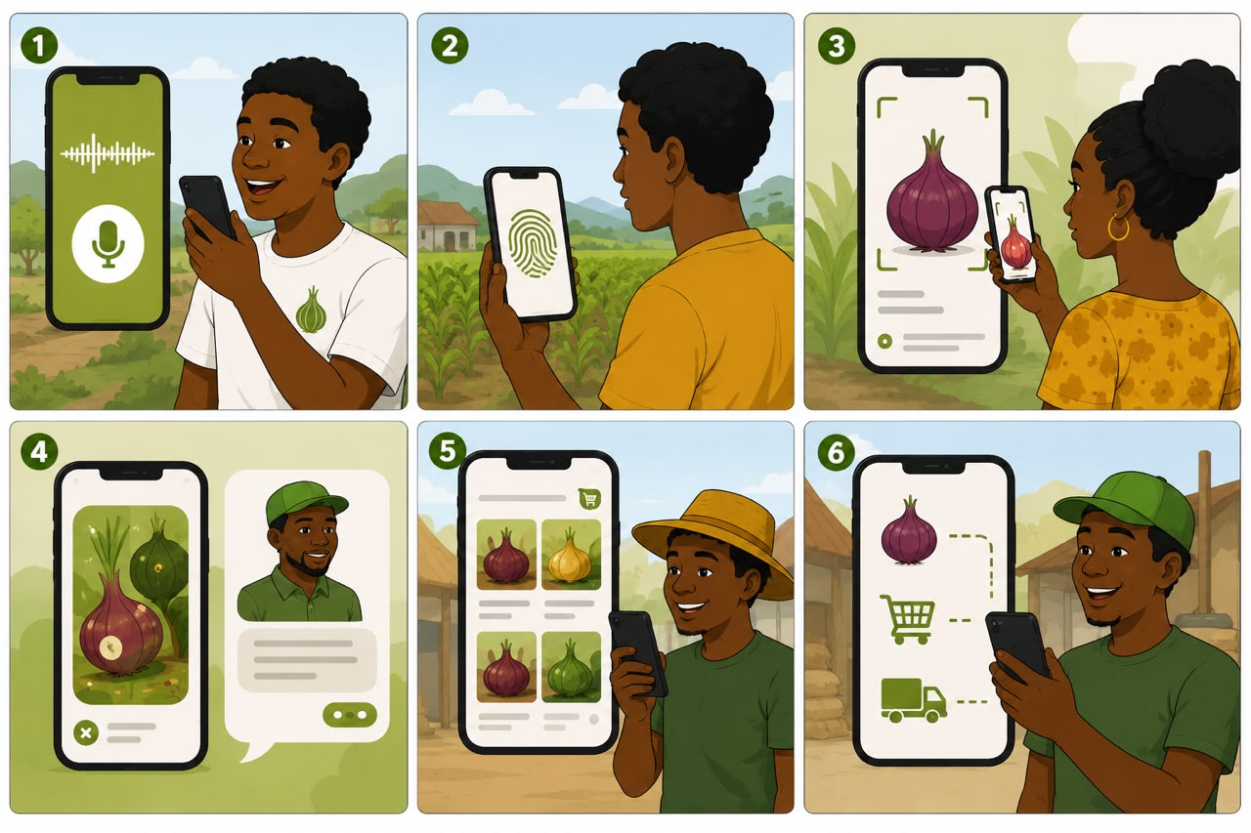

Slide 12
THE PRODUCT
The Wider Product Ecosystem
Local-language voice guidance, so the product is accessible regardless of literacy level
Biometric authentication for secure, reliable access
Enhanced agricultural advisory support
Farm records to track history, treatment and yield
Marketplace features connecting farmers directly to buyers
Data and reporting functions for institutional partners
ONION GUARD
OG
ONION GUARD | UG NKABOM HONOURS PROGRAMME

Slide 13
THE STRATEGIC CHALLENGE
Building the Product and Building the Market
WHERE ONION GUARD IS TODAY
1
2
3
4
5
Research
→
Ideation
→
Field
Research
→
System
Design
→
Prototype
Development
THE NEXT PHASE MUST MOVE THE PRODUCT TOWARD
1
2
3
4
5
Refinement
→
Testing
→
Validation
→
Adoption
→
Commercialisation
DEVELOP THE PRODUCT
DEVELOP THE MARKET
Improve, test and refine the application itself.
Create awareness, attract users, build partnerships and test commercial opportunities.
OG
ONION GUARD | UG NKABOM HONOURS PROGRAMME

Slide 14
03
AUDIENCE & STAKEHOLDERS
Onion Guard serves farmers, extension officers, buyers and consumers directly, while institutions become the strongest path to commercial scale.
OG
ONION GUARD | UG NKABOM HONOURS PROGRAMME

Slide 15
PRIMARY USERS
Who Onion Guard Serves Directly
SEGMENT
THEIR NEED
DESIRED CONVERSION PATH
FARMERS
Accessible disease ID, agricultural information, practical guidance, better buyer access, affordable tools
DOWNLOAD → TEST → USE → RETURN
AGRICULTURAL EXTENSION OFFICERS
Tools to support multiple farmers, faster access to information, digital support for field services
TEST → VALIDATE → RECOMMEND → ADOPT
BUYERS & AGGREGATORS
Better access to farmers and producers, more efficient market linkages
EXPLORE → CONNECT → TRANSACT
CONSUMERS
Greater confidence in food quality and safety, accessible information
DISCOVER → CHECK → TRUST
OG
ONION GUARD | UG NKABOM HONOURS PROGRAMME

Slide 16
INSTITUTIONAL & COMMERCIAL STAKEHOLDERS
The Organisations That Can Scale Onion Guard
THESE MAY INCLUDE
Government agricultural agencies
NGOs & development organisations
THEIR POTENTIAL ROLE
Paying customers
Institutional licenses
Sponsors
Testing partners
Distribution partners
Farmer-based organisations
Agribusinesses
Technology organisations & innovation hubs
Research institutions
OG
ONION GUARD | UG NKABOM HONOURS PROGRAMME

Slide 17
04
OBJECTIVES & STRATEGY
What Success
Looks Like
OG
ONION GUARD | UG NKABOM HONOURS PROGRAMME

Slide 18
PROGRAMME OBJECTIVES
Awareness, Visibility, Conversion
PRIMARY OBJECTIVE
Transition Onion Guard from a functional prototype into a technically improved, tested, validated, visible and commercially positioned agricultural technology solution within six months.
AWARENESS
VISIBILITY
CONVERSION
Introduce Onion Guard to agricultural, technology, business, innovation and institutional audiences
Create awareness of the problem the product addresses
Introduce the scholars and innovators behind the product
Generate awareness through the launch, digital content, media and strategic events
Produce 26 core digital content pieces over six months (one per week)
Generate media and PR opportunities around the launch and milestones
Document the product-development journey
Amplify farm testing, events, pitches and product improvements
Recruit and engage beta testers; test across a minimum of five farms
Participate in at least five strategic events, showcases or pitch sessions
Work toward up to three signed MOUs by Month 5
Test interest in licensing, sponsorship, subscriptions and advertising
OG
ONION GUARD | UG NKABOM HONOURS PROGRAMME

Slide 19
SIX-MONTH GROWTH TARGETS
Measurable Conversion Targets
100
400
1,000
Beta testers
recruited in
Months 1–2
Active users
by Months
3–4
Active daily
users by end
of Month 6
5
5
3
Farms tested
cumulatively
Strategic events,
showcases or
pitch sessions
Signed MOUs
targeted by
Month 5
OG
ONION GUARD | UG NKABOM HONOURS PROGRAMME

Slide 20
THE BIG IDEA
WHAT IF WE COULD?
Every innovation begins with a question. For Onion Guard, the question keeps expanding, and the six-month programme becomes the process of answering it.
What if we could identify crop disease earlier?
What if we could help farmers easily access helpful information?
What if we could connect farmers to buyers?
What if we could make food safety information more accessible?
What if young Ghanaian innovators could build solutions for the challenges around them?
What if a prototype could become a nationwide adopted product?
BUILD IT. TEST IT. LEARN FROM PEOPLE. IMPROVE IT. TAKE IT FURTHER.
OG
ONION GUARD | UG NKABOM HONOURS PROGRAMME

Slide 21
THE STRATEGIC FRAMEWORK
Problem to Potential
1
2
3
4
5
6
Problem
Possibility
Prototype
Proof
Partnership
Potential
A real gap in Ghana's onion value chain
AI, mobile and youth innovation converge
A working, tested application
Field validation and real user feedback
Institutions engage and pilot
Commercial and scale pathway
AWARENESS
VISIBILITY
VALIDATION
CONVERSION
COMMERCIALISATION
Introduce the problem, the product and the people
Document and amplify the journey
Test the product with real users
Move interested stakeholders toward action
Convert validated interest into partnerships and revenue
OG
ONION GUARD | UG NKABOM HONOURS PROGRAMME

Slide 22
05
CONTENT & STORYTELLING
The Programme
Is the Content
OG
ONION GUARD | UG NKABOM HONOURS PROGRAMME

Slide 23
CONTENT STRATEGY
Three Content Pillars
REAL-WORLD ACTIVITY → STORY → DIGITAL AMPLIFICATION → INTEREST → ACTION
THE IMPACT
BEHIND THE INNOVATION
LEARN WITH ONION GUARD
Show what Onion Guard can do and why it matters.
Show the people and process behind the product.
Provide genuinely useful information.
User stories & farmer experiences
Product benefits & testing outcomes
Problem / solution stories
Evidence of value
The scholars & the team
The development process
Failed ideas & technical challenges
Unexpected discoveries
Onion health & agricultural education
Food safety & AI in agriculture
App tutorials & walkthroughs
Frequently asked questions
OG
ONION GUARD | UG NKABOM HONOURS PROGRAMME

Slide 24
EXECUTION
The Weekly Content System
ONE CORE CONTENT PIECE PER WEEK → APPROXIMATELY 26 PIECES ACROSS SIX MONTHS
Each weekly piece connects directly to that month's real programme activity — and adapts into video, social posts, website content and media opportunities.
MONTH 1
What if we could solve a problem we'd already seen? · Meet the team · What did the research reveal? · Idea to prototype
MONTH 2
People begin testing · What does the app do? · What are we changing? · The countdown to launch
MONTH 3
The launch: What If We Could? · What happened at the showcase · Taking it to the field · First real-world test
MONTH 4
What did users say? · What did we change? · Testing the next version · Technology meets the real world
MONTH 5
Onion Guard meets the innovation ecosystem · Pitching the possibility · What adoption takes · Interest to partnership
MONTH 6
What have we learned? · What changed · What comes next · Could Onion Guard become Crop Guard?
OG
ONION GUARD | UG NKABOM HONOURS PROGRAMME

Slide 25
06
SIX-MONTH EXECUTION ROADMAP
A month-by-month plan that develops the product and the market at the same time.
OG
ONION GUARD | UG NKABOM HONOURS PROGRAMME

Slide 26
THE SIX-MONTH PLAN
Roadmap
M1
M2
M3
M4
M5
M6
Prepare
& Refine
→
Beta Test &
Prepare Launch
→
Launch & Begin
Field Validation
→
Test, Learn
& Improve
→
Pitch, Partner
& Commercialise
→
Consolidate
& Scale
OG
ONION GUARD | UG NKABOM HONOURS PROGRAMME

Slide 27
MONTH 1 OF 6
Prepare and Refine
PRIMARY FOCUS
CONVERSION TARGET
Prepare the product, people and programme for testing.
AWARENESS → INTEREST
PRODUCT
VALIDATION
COMMERCIALISATION
COMMUNICATIONS
Technical audit
Identify technical gaps
Prioritise features
Begin AI model refinement
Establish technical milestones
Identify 5+ potential farms
Identify beta testers
Identify extension officers
Develop testing framework
Map potential institutional partners
Identify potential sponsors
Develop initial partnership proposition
Introduce the problem
Introduce the team
Begin ‘What If We Could?’ storytelling
Document early development
OG
ONION GUARD | UG NKABOM HONOURS PROGRAMME

Slide 28
MONTH 2 OF 6
Beta Test and Prepare to Launch
PRIMARY FOCUS
CONVERSION TARGET
Improve the product through early user feedback while preparing for public launch.
INTEREST → TRIAL
PRODUCT
VALIDATION
LAUNCH PREP
COMMERCIALISATION
Continue AI refinement
Continue priority development
Conduct beta testing
Identify technical issues
Begin first iteration
Onboard initial beta testers
Test core functions
Collect structured feedback
Develop the launch experience
Prepare demonstration
Develop media materials
Prepare stakeholder invitations
Identify launch invitees with partnership potential
Begin early institutional conversations
OG
ONION GUARD | UG NKABOM HONOURS PROGRAMME

Slide 29
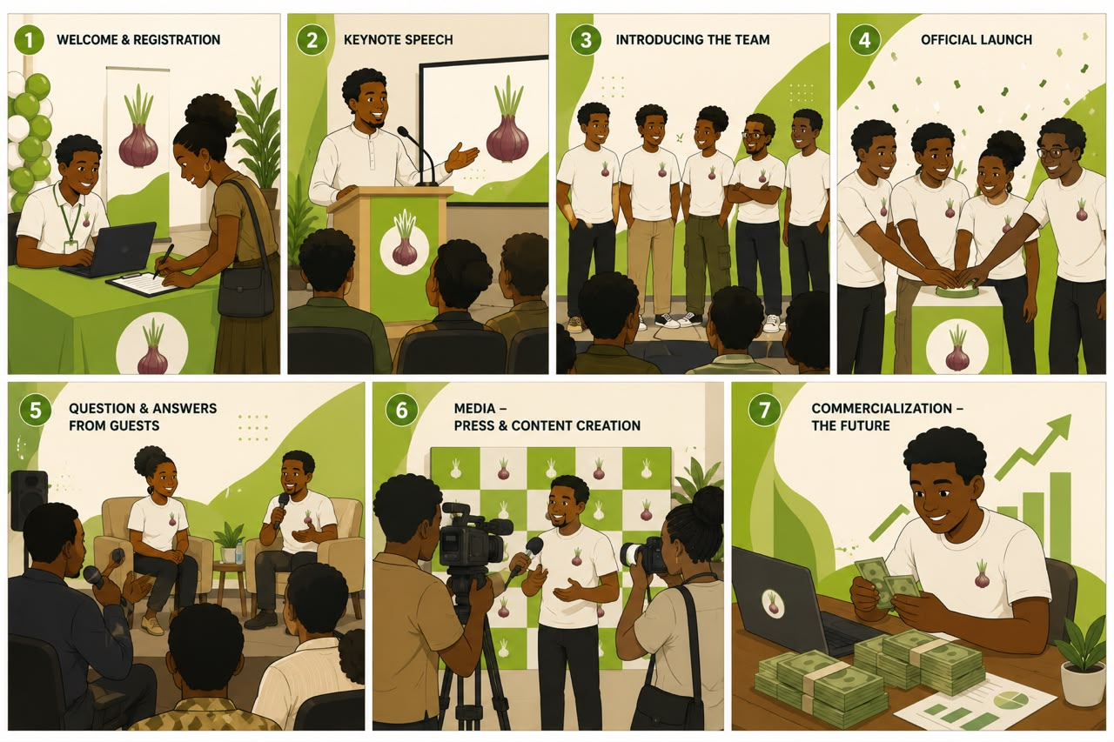

Slide 30
MONTH 3 OF 6
Launch and Begin Field Validation
PRIMARY FOCUS
CONVERSION TARGET
Officially launch the refined product and begin real-world testing.
INTEREST → ENGAGEMENT → TRIAL
FLAGSHIP ACTIVITY
FIELD VALIDATION
COMMUNICATIONS
COMMERCIALISATION
‘What If We Could?’ — the Onion Guard Innovation Showcase
Brings together the problem, research, team, journey, product, stakeholders, and a live demonstration
Begin testing Onion Guard on the first farms
Amplify the launch, the live demo, media coverage and stakeholder reactions
Follow up with launch attendees
Identify qualified leads
Schedule partnership conversations
OG
ONION GUARD | UG NKABOM HONOURS PROGRAMME

Slide 31
MONTH 4 OF 6
Test, Learn and Improve
PRIMARY FOCUS
CONVERSION TARGET
Use real-world feedback to improve the product.
TRIAL → REPEAT USE → ADVOCACY
VALIDATION
PRODUCT
EVENTS
DIGITAL AMPLIFICATION
Continue farm testing
Reach 3+ farms cumulatively
Engage farmers and stakeholders
Collect structured feedback
Analyse feedback
Identify priority improvements
Implement improvements
Conduct second iteration
Participate in agrifood, agribusiness, innovation and technology events
Document farm testing, user experiences, challenges and improvements
OG
ONION GUARD | UG NKABOM HONOURS PROGRAMME

Slide 32
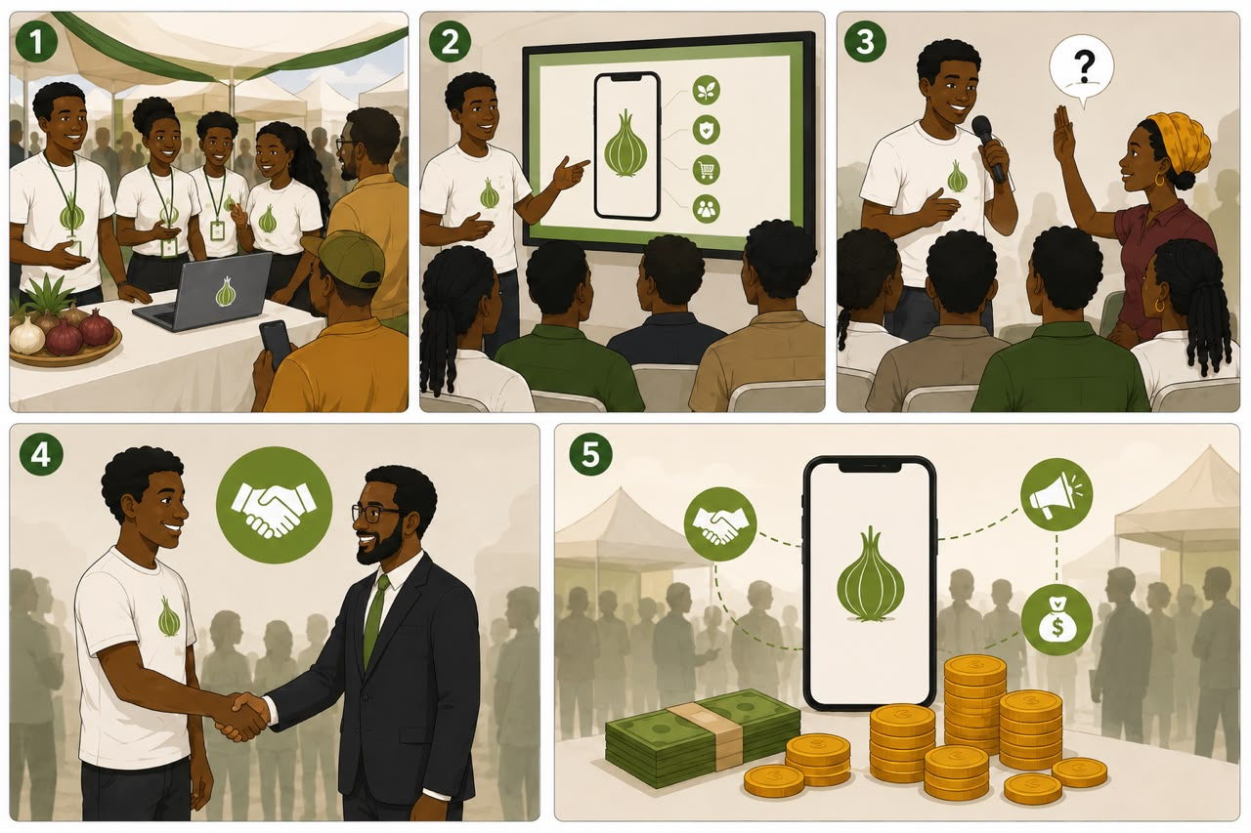

Slide 33
MONTH 5 OF 6
Pitch, Partner and Commercialise
PRIMARY FOCUS
CONVERSION TARGET
Turn product validation and visibility into concrete opportunities.
INTEREST → PARTNERSHIP → COMMERCIAL OPPORTUNITY
EVENTS
PARTNERS
COMMERCIALISATION
PARTNERSHIP CONVERSION
CircularEconomy4Ghana Innovation Challenge
Timbuktoo Pan-African AgriTech Incubation Programme
Eagles Nest Agribusiness Pitch Arena
Ministry of Food and Agriculture
University of Ghana Farms
Trias
Crops Research Institute (CSIR)
Timbuktoo AgriTech Hub
Agriseed
YARA Ghana
Agogo Onion Farmers Association
Accra Onion Sellers and Importers Cooperative Society
Test licensing, sponsored access, subscriptions, advertising and marketplace interest
Move qualified prospects toward pilots, proposals, letters of intent and MOUs
OG
ONION GUARD | UG NKABOM HONOURS PROGRAMME

Slide 34
MONTH 6 OF 6
Consolidate and Scale
PRIMARY FOCUS
CONVERSION TARGET
Evaluate the pilot and define the next stage.
ADOPTION → PARTNERSHIP → NEXT-STAGE ROADMAP
PRODUCT
VALIDATION
COMMERCIALISATION
COMMUNICATIONS
Final product review
Review technical performance
Review user feedback
Identify remaining improvements
Analyse testing results
Document user insights
Evaluate adoption signals
Review customer segments
Assess partnership pipeline
Identify strongest commercial pathways
Tell the six-month story: what did we ask, build, learn, and what happens next
OG
ONION GUARD | UG NKABOM HONOURS PROGRAMME

Slide 35
REAL-WORLD VALIDATION
The Field Testing Programme
Step | Farmer Journey | Farmer Need / Behaviour | Onion Guard Opportunity
1. Detection | Observes a change in the crop, such as wilting or spots. | Needs to identify that something may be wrong. | Push notification or a simple “Open Camera” shortcut to begin diagnosis.
2. Verification | Is unsure whether the problem is a disease or nutrient deficiency. | Needs a reliable diagnosis. | AI-powered image scan providing a confidence score and visual match.
3. Decision | Needs to know whether the crop is salvageable. | Needs clear guidance on what action to take. | Actionable advice, e.g., “Remove plant” or “Use [X] treatment.”
4. Connection | Wants to sell the remaining harvest. | Needs access to potential buyers or aggregators. | Marketplace button to list produce for local aggregators.
5. Trust | Relies on human guidance and expert reassurance. | Needs access to a trusted agricultural professional. | “Contact Local Extension Officer” button for remote consultation.
TESTING ACROSS A MINIMUM OF FIVE FARMS
OG
ONION GUARD | UG NKABOM HONOURS PROGRAMME

Slide 36
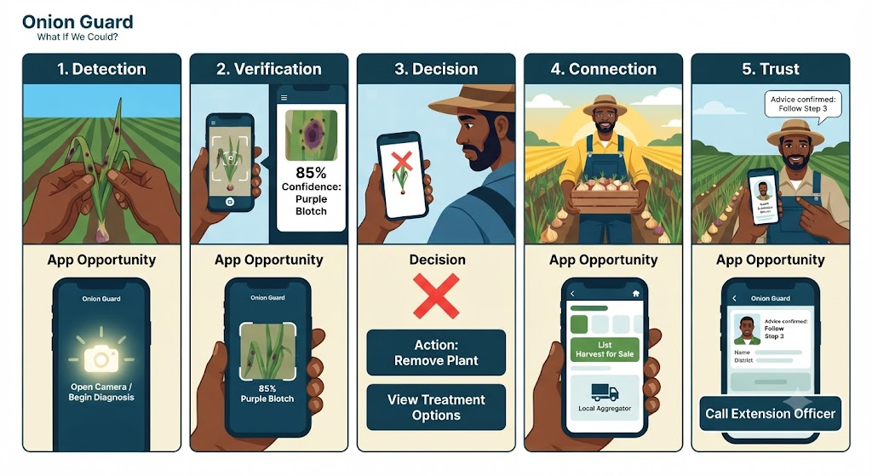
REAL-WORLD VALIDATION
TESTING ACROSS A MINIMUM OF FIVE FARMS
OG
ONION GUARD | UG NKABOM HONOURS PROGRAMME

Slide 37
REAL-WORLD VALIDATION
The Field Testing Programme Continued
TESTING ACROSS A MINIMUM OF FIVE FARMS
Step | Extension Officer Journey | Current Behaviour / Need | Onion Guard Opportunity
1. Diagnostic | Visits a farm and spends time assessing the problem. | Needs an efficient way to conduct an initial assessment. | Uses Onion Guard to provide a data-backed initial assessment.
2. Education | Explains the disease to the farmer. | Needs clear and accessible educational materials. | Shares digital pamphlets and tips via the app’s Advisory tab.
3. Tracking | Records the issue in a manual logbook. | Needs an efficient way to document and retrieve cases. | Automatic logging of the issue in the platform’s database.
4. Scaling | Moves on to the next farm. | Needs to identify broader disease patterns across their area. | Dashboard overview of disease trends within their specific district.
OG
ONION GUARD | UG NKABOM HONOURS PROGRAMME

Slide 38
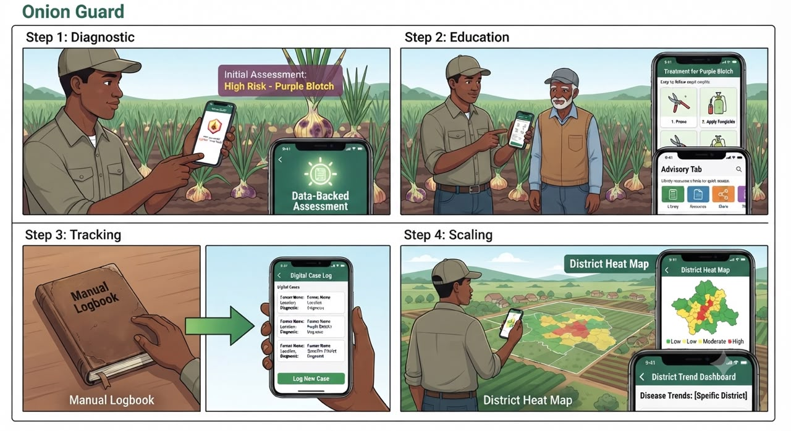
REAL-WORLD VALIDATION
TESTING ACROSS A MINIMUM OF FIVE FARMS
OG
ONION GUARD | UG NKABOM HONOURS PROGRAMME

Slide 39
COMMERCIALISATION
The Revenue Model
KEY PRINCIPLE: the person who uses the platform does not always have to be the person who pays for it.
Institution → Onion Guard → Extension Officer → Farmer
Freemium Access
Institutional Licensing
Sponsored Farmer Access
Free basic tier; premium users pay for extra scans, insights and marketplace features
Organisations purchase access for farmers, extension officers or programmes
A company or NGO sponsors access for a defined group of farmers
Extension Licensing
Marketplace Fees
In-App Advertising
Individual, district-level, org-wide or custom institutional packages
Commission on transactions, premium listings, featured placements
Sponsored tips, banner/video ads, rewarded advertising from agri-input firms
Future Technology Licensing
OG
The underlying AI adapted to tomato, pepper, maize and cassava
ONION GUARD | UG NKABOM HONOURS PROGRAMME

Slide 40
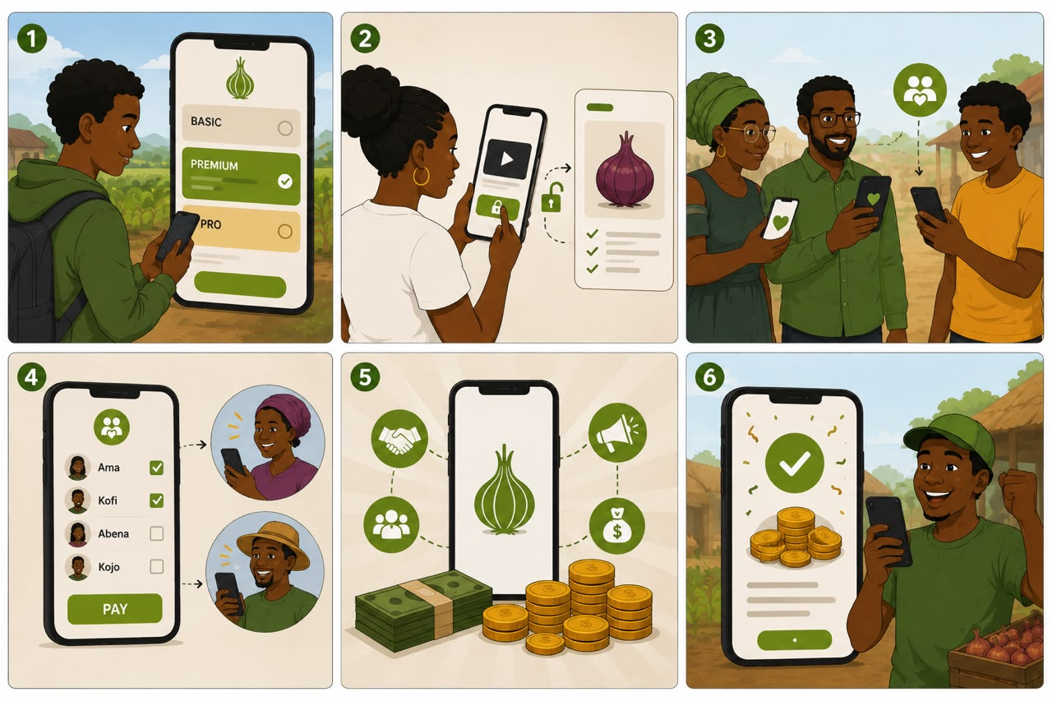

Slide 41
08
RESOURCES, BUDGET & MEASUREMENT
What It Takes
to Deliver
OG
ONION GUARD | UG NKABOM HONOURS PROGRAMME

Slide 42
WHAT THE PROGRAMME NEEDS
Resources Required
HUMAN RESOURCES
TECHNICAL RESOURCES
FIELD RESOURCES
COMMUNICATIONS & COMMERCIALISATION
AI/ML & mobile development team
Programme lead & project coordinator
Agricultural scientist / crop specialist
Field coordinator & research assistants
Creative strategist, copywriter, videographer, designer
Business development / commercialisation lead
Development laptops & testing devices
Cloud hosting & AI/ML infrastructure
APIs & database infrastructure
App analytics & testing environments
Cybersecurity tools
Access to a minimum of five farms
Agricultural experts & extension officers
Crop disease reference materials
Field-testing protocols & data tools
Transportation to field sites
Camera, audio and lighting equipment
Editing and graphic design software
Press, launch and pitch materials
Partnership and MOU development support
OG
ONION GUARD | UG NKABOM HONOURS PROGRAMME

Slide 43
INDICATIVE SIX-MONTH BUDGET
Product-First Investment
A planning estimate, to be refined following technical audit, AI model assessment and development quotation.
BUDGET CATEGORY
ALLOCATION
Product Development & Technical Investment
GHS 100,000
Validation & Field Testing
GHS 10,000
Launch & Visibility
GHS 5,000
Events & Partnerships
GHS 5,000
Contingency
GHS 11,500
INDICATIVE TOTAL
GHS 131,000
OG
ONION GUARD | UG NKABOM HONOURS PROGRAMME

Slide 44
MEASUREMENT
The KPI Framework
AWARENESS
VISIBILITY
PRODUCT
Reach, impressions, video views
Media mentions
Website traffic; event attendance
26 core content pieces
Content engagement
Media & stakeholder mentions
AI model refinement
Feature completion
Product iterations
USER
PARTNERSHIP
COMMERCIAL
Users onboarded & active
Repeat users; retention
Testing completion
Qualified leads & meetings
Pilot opportunities
Up to 3 MOUs by Month 5
Paying-customer prospects
Licensing / sponsorship leads
Revenue opportunities identified
OG
ONION GUARD | UG NKABOM HONOURS PROGRAMME

Slide 45
GOVERNANCE
Risks and Mitigation
RISK TYPE
DESCRIPTION
MITIGATION
Technical
The AI model may not perform accurately enough
Continuous testing, fine-tuning and validation
User Adoption
Users may be interested but fail to adopt the product
User testing, feedback-driven iteration, simplified onboarding
Partnership
Potential partners may express interest without formalising
Structured follow-up, clear propositions, defined pilots
Commercial
The initial revenue model may not be viable
Test multiple commercialisation pathways rather than one
Resource
The programme may require more technical development than anticipated
Prioritise features; allocate majority of budget to technical development
OG
ONION GUARD | UG NKABOM HONOURS PROGRAMME

Slide 46
SIX MONTHS FROM NOW
Expected Outcomes
1
A Better Product
2
Real-World Validation
Technically improved and better-tested application
Testing completed across a minimum of five farms
3
Greater Awareness
4
Greater Visibility
More people aware of Onion Guard and the problem it addresses
A fully documented six-month innovation journey
5
Stronger Stakeholder Interest
6
Partnership Opportunities
Engagement across agricultural, tech, business and institutional audiences
A pipeline of potential institutional and strategic partners
7
Commercial Learning
8
A Clearer Path to Scale
Evidence of who wants the product, what they value, and who may pay
A post-pilot roadmap for growth, product, partnerships and funding
OG
ONION GUARD | UG NKABOM HONOURS PROGRAMME

Slide 47
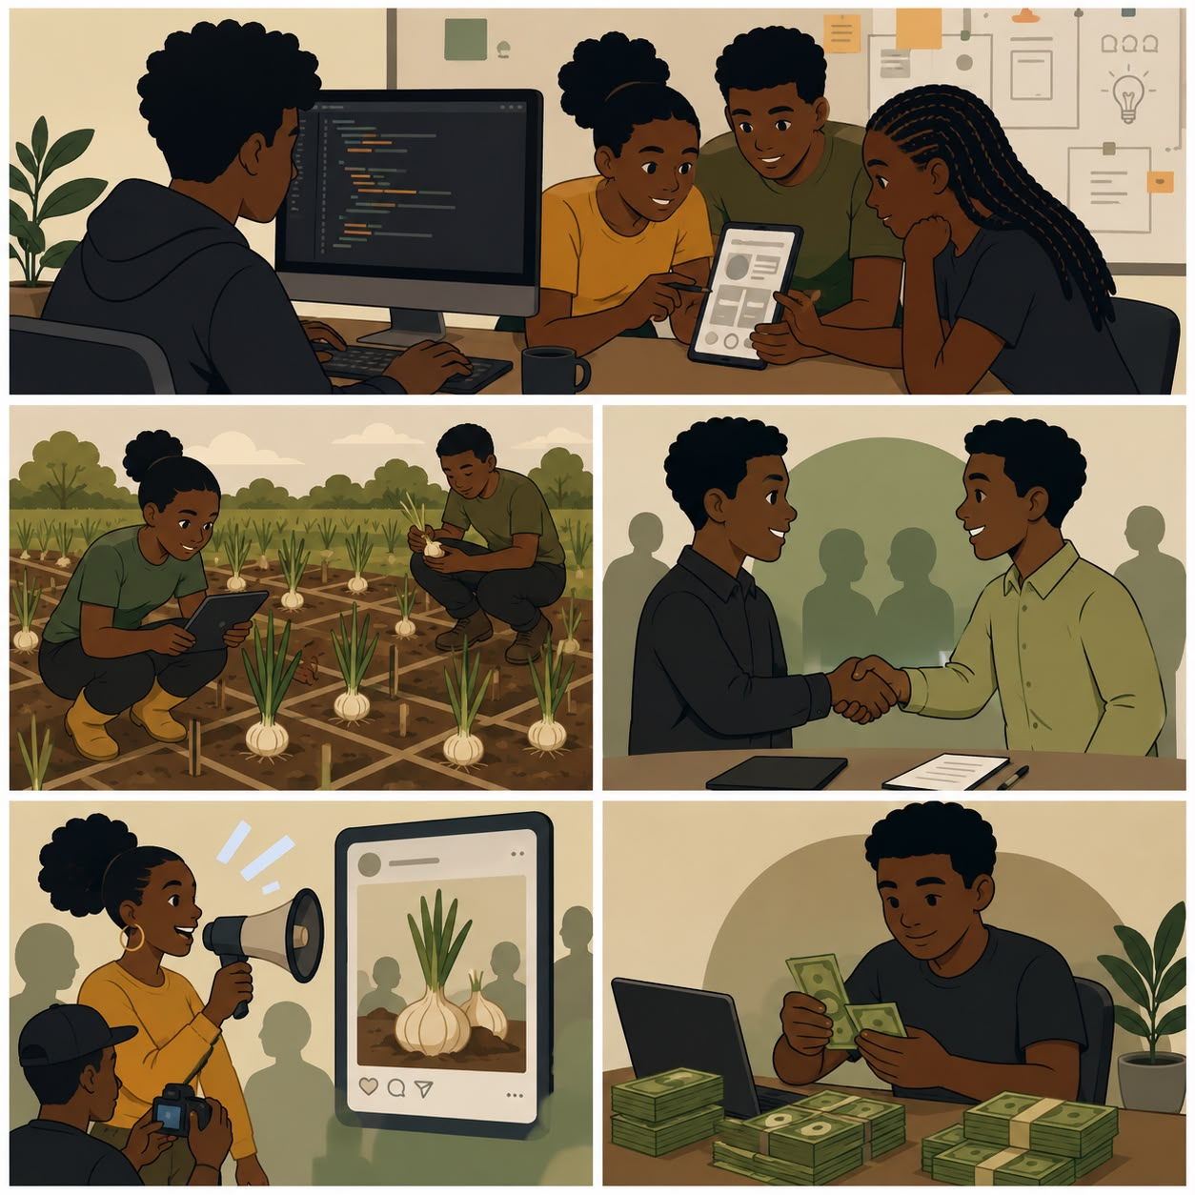
THE ROAD AHEAD
→
CROP GUARD
ONION GUARD
A broader platform for agricultural intelligence, disease detection and value-chain support across multiple crops.
WHAT IF WE COULD?
OG
ONION GUARD | UG NKABOM HONOURS PROGRAMME

Slide 48
What if we could start work this Monday?
WHAT IF WE COULD?
OG
ONION GUARD | UG NKABOM HONOURS PROGRAMME

